Slide 1
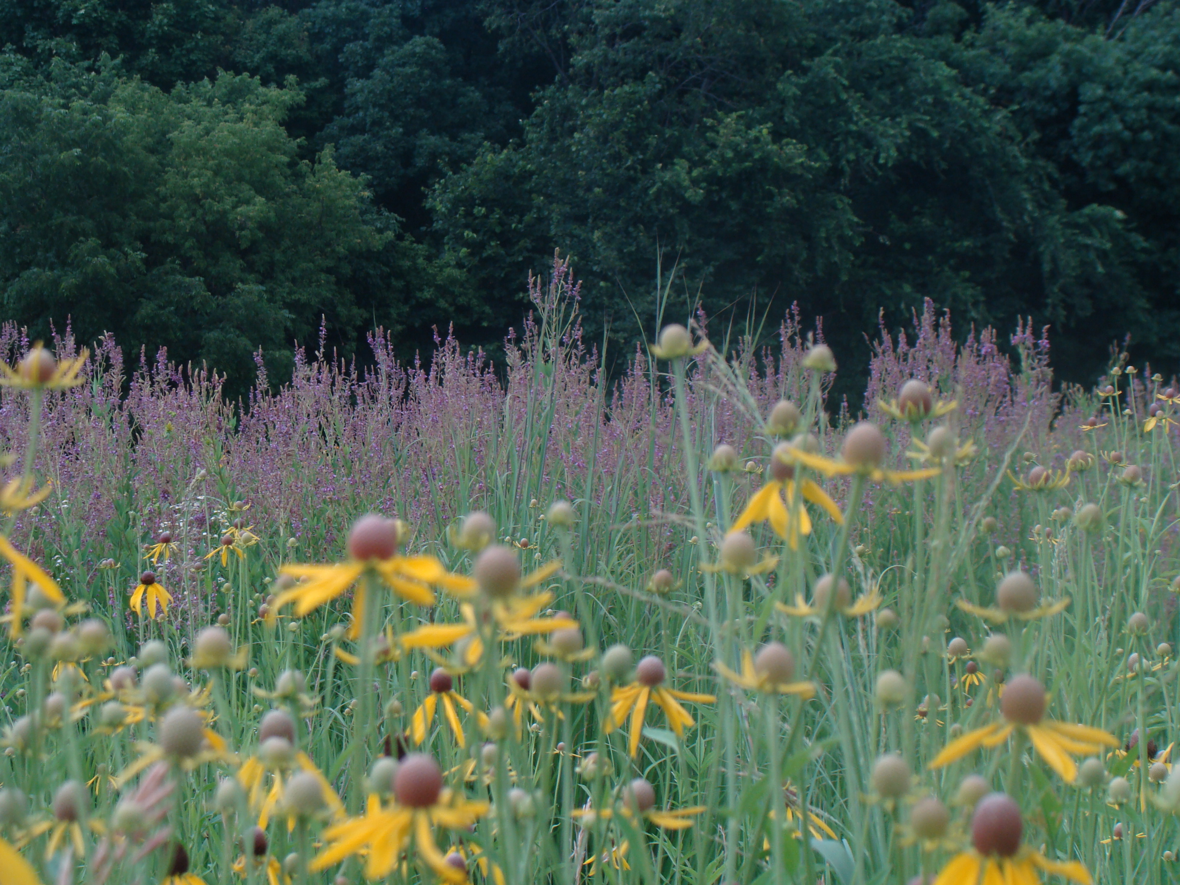
Prairie Tour
July 14, 2019
Marjie &Tom Bennett

Slide 2
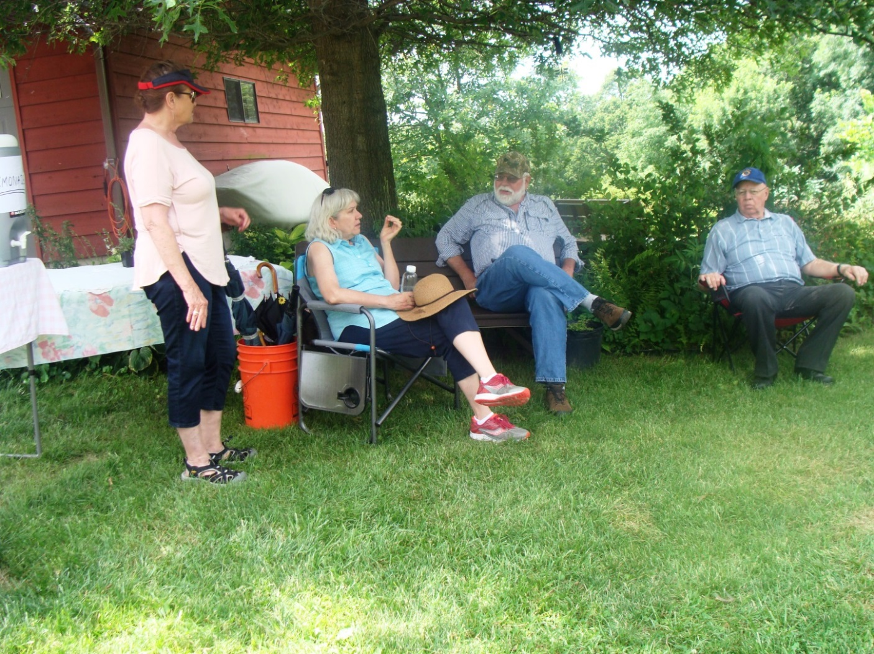
Gathered to hear Gary Eldridge, speaker on restoring prairies.

Slide 3
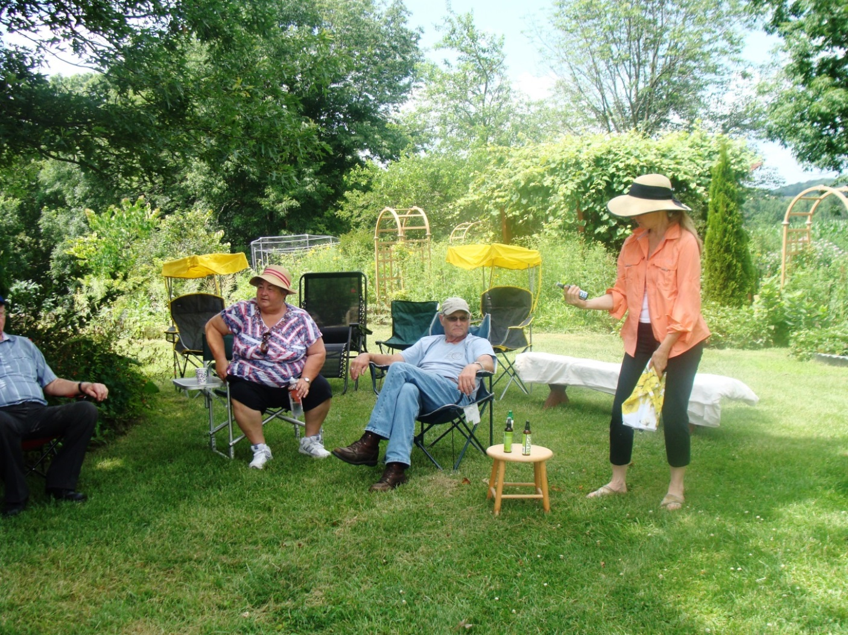
Marjie picking out best bug spray to use!

Slide 4
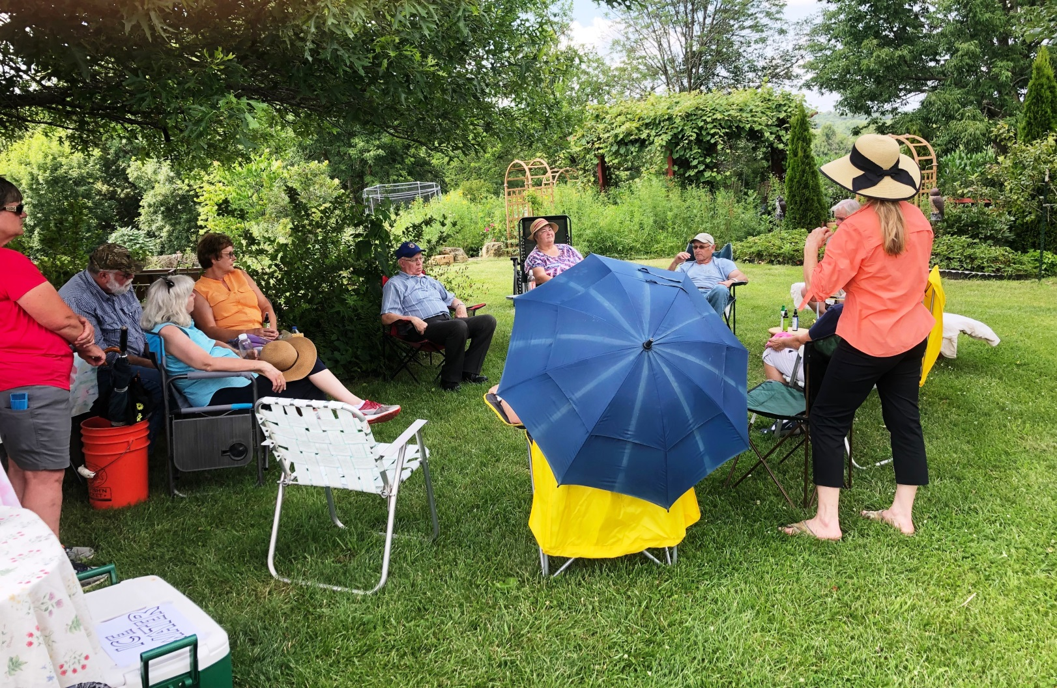
Umbrellas sure helped that day!

Slide 5
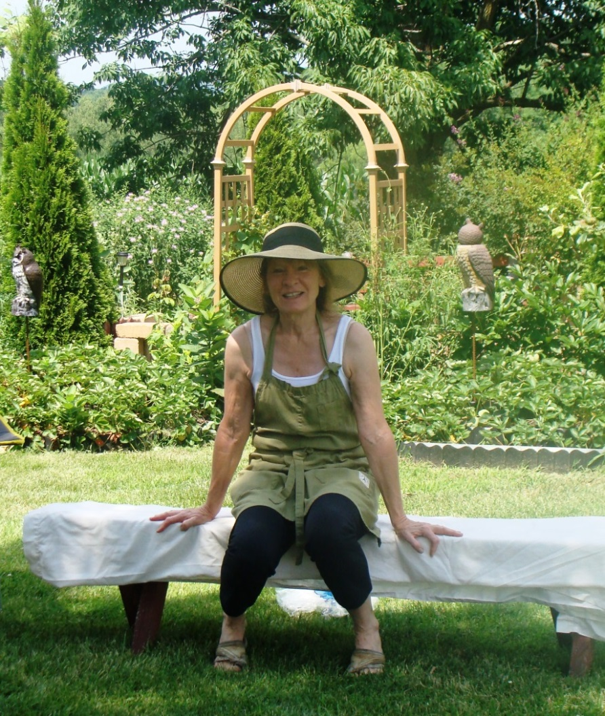
Marjie with her pollinator garden in the background.

Slide 6
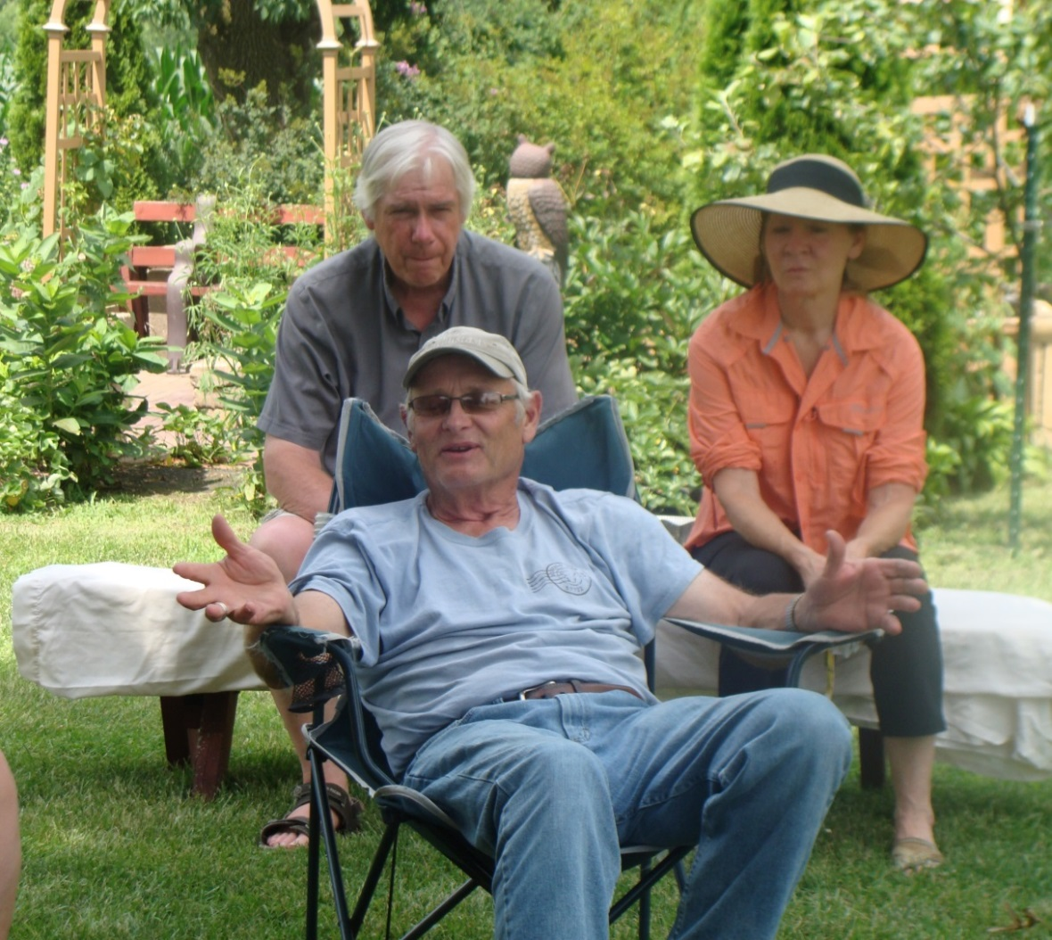
Gary Eldridge and our hosts of the tour, Tom and Marjie.

Slide 7
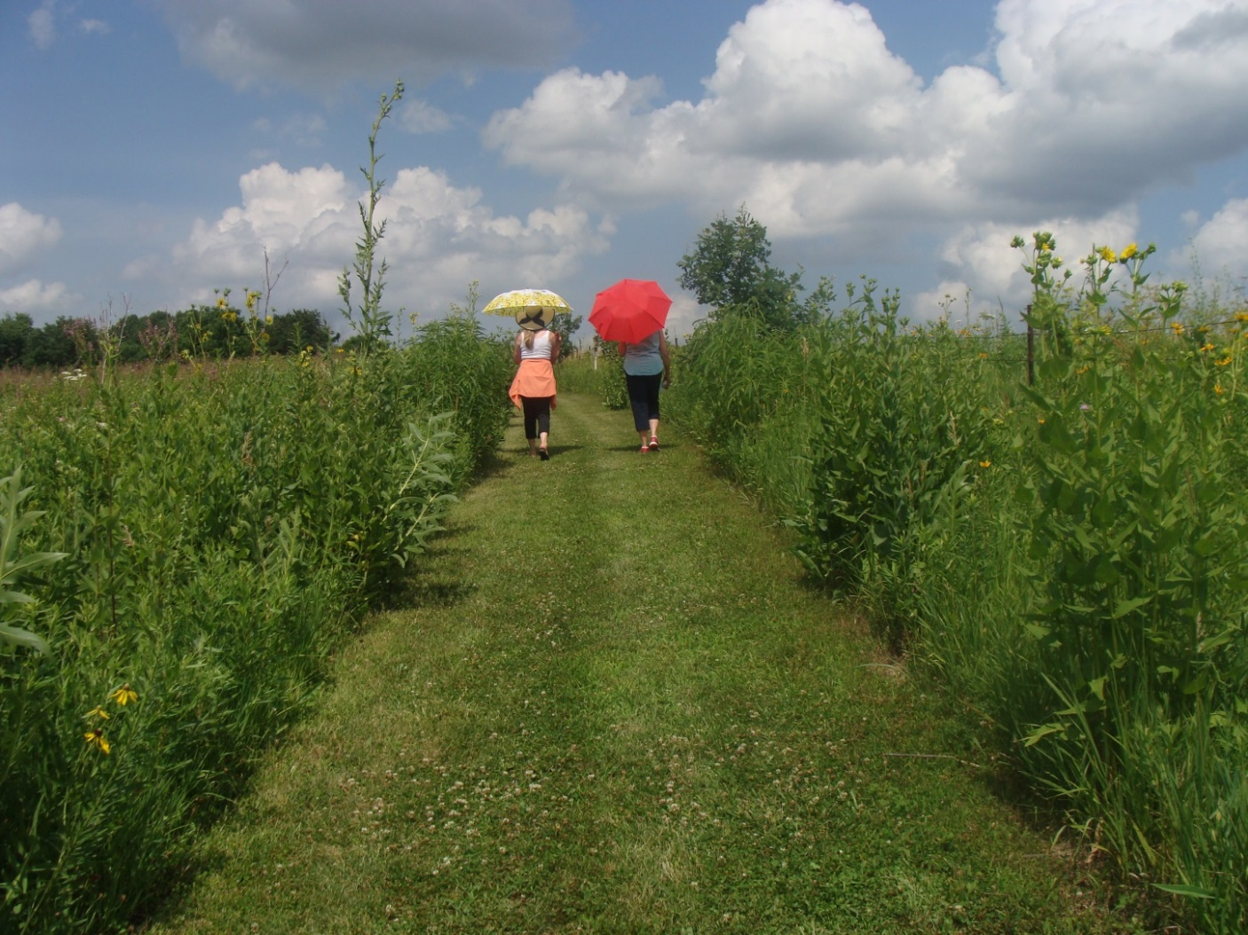
Planting the tall grasses and wildflowers has environmental benefits.

Slide 8
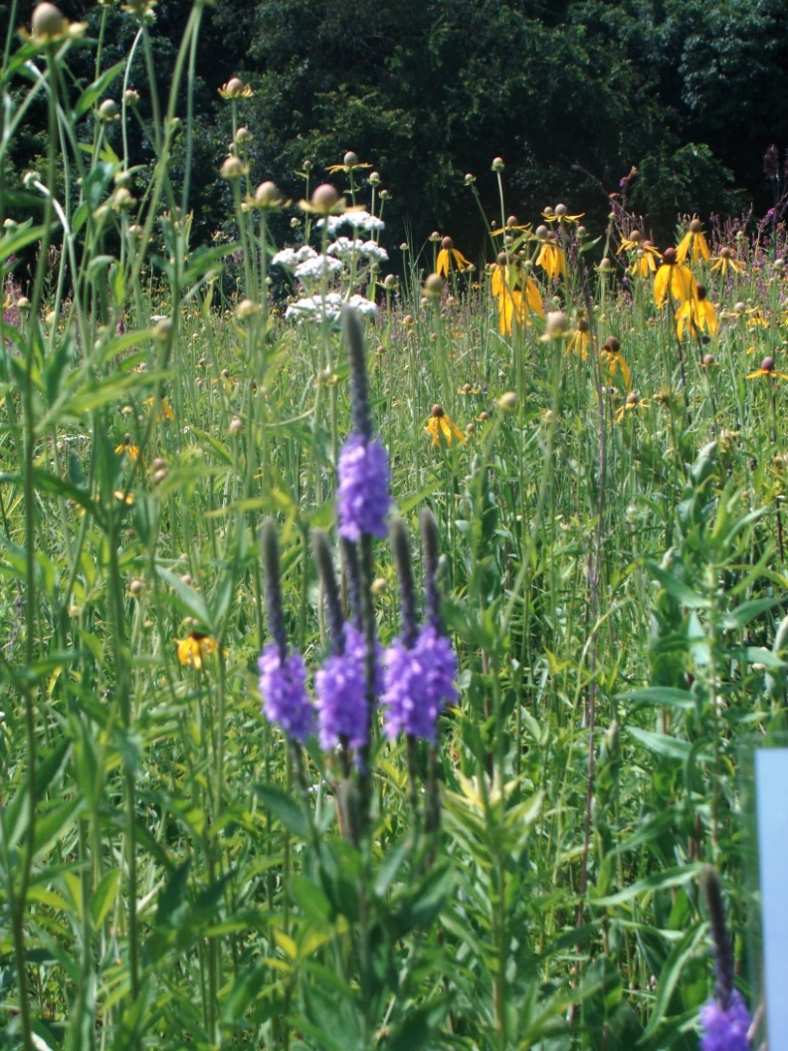
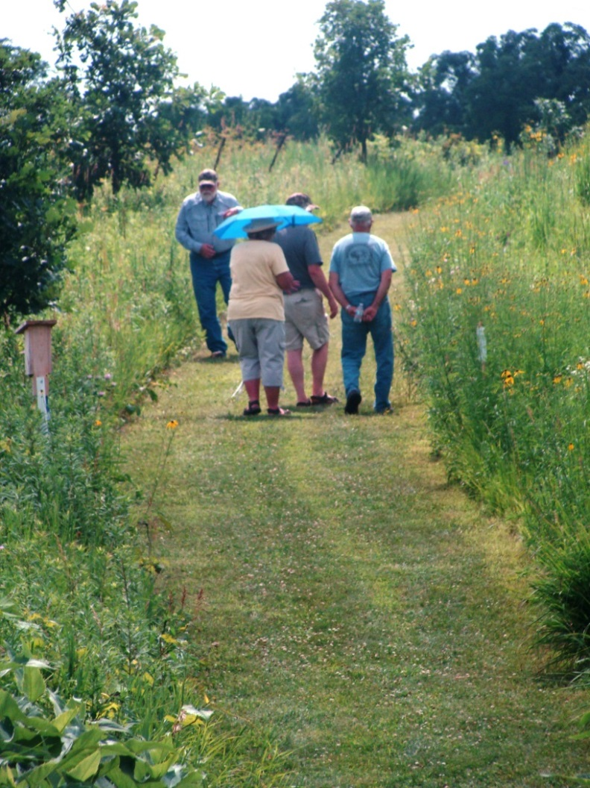
Amazing prairie!

Slide 9
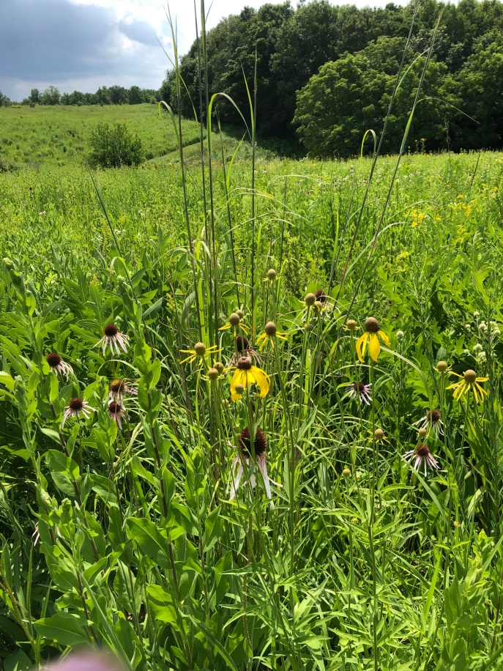
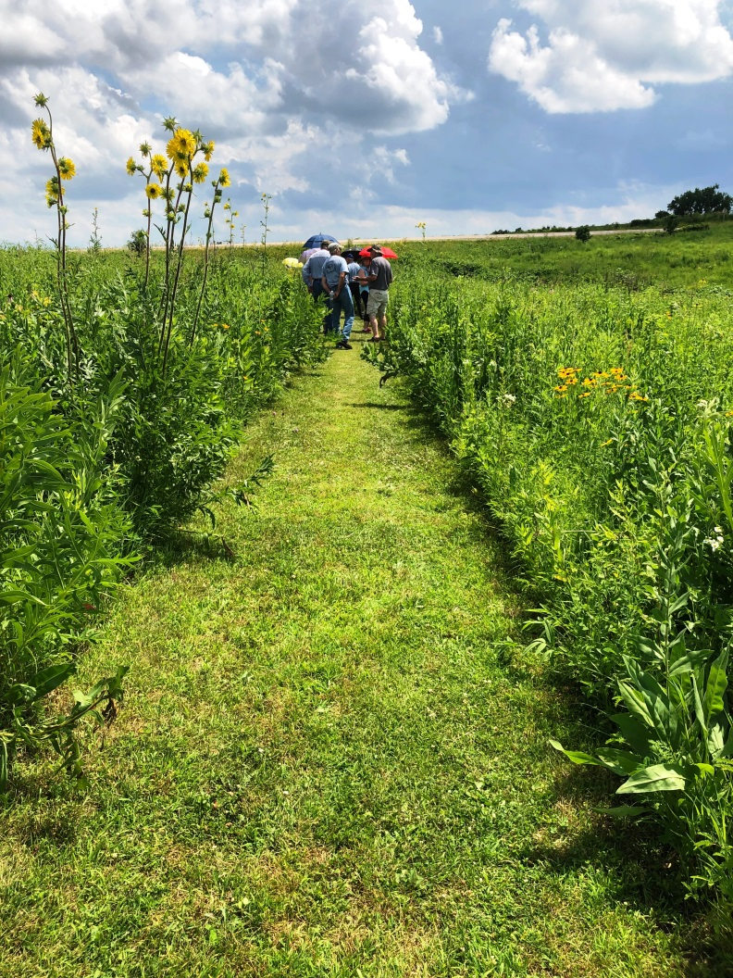
Background on the right photo shows the new area planted directly without spraying first..

Slide 10

Attracting birds, butterflies & bees is easy if you choose the plants they need. GO NATIVE!

