Slide 1
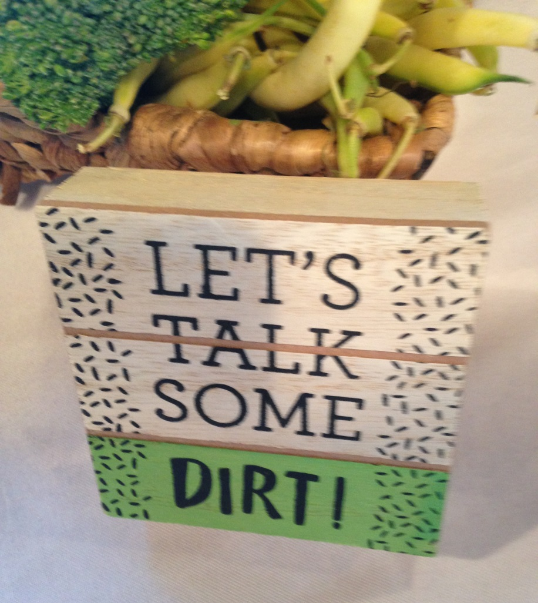
Gardens, Greens and Gadgets
August 1, 2018
Vesperman Farms, Lancaster

Slide 2
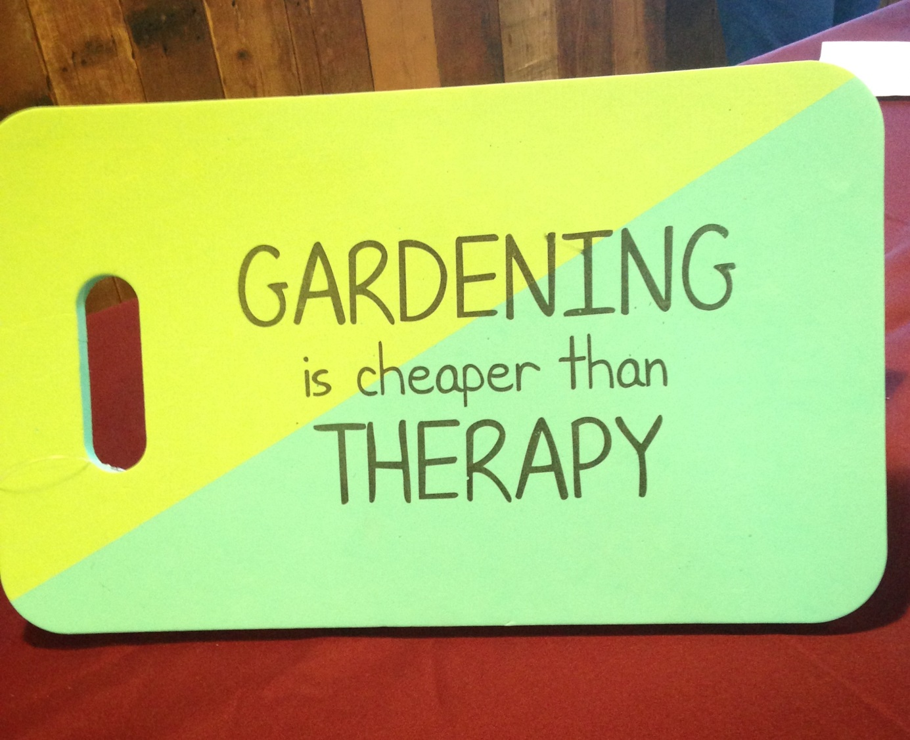
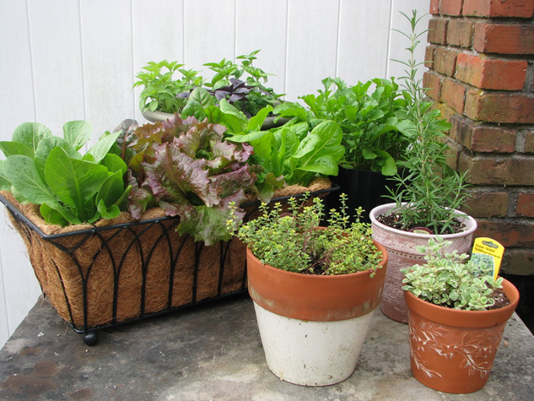
This is so true!

Slide 3
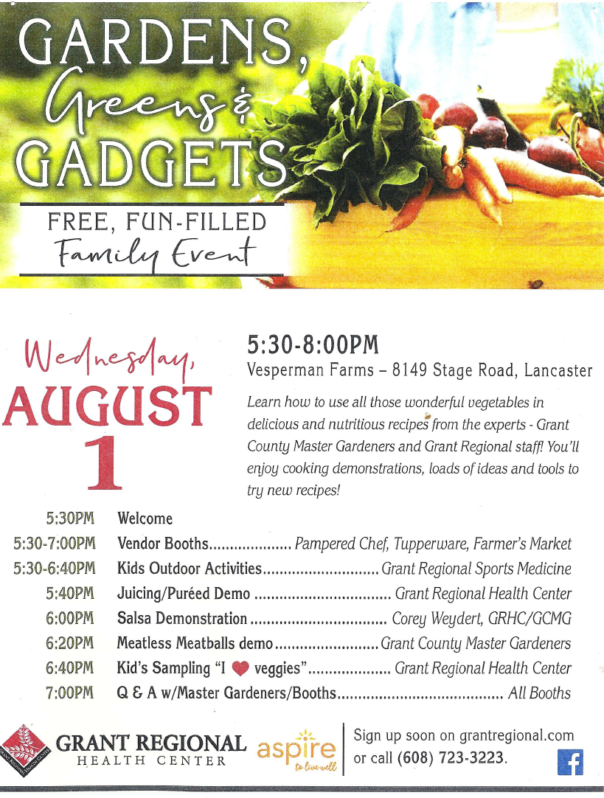
Several Grant county master gardener volunteers under leadership of Corey Weydert participated in the first fun-filled event sponsored by Grant Regional, Lancaster.
Would we do it again? As a participant, I would say, “Definitely because we had face-to-face interaction with interested gardeners and who also wanted to know how to offer healthy foods to their family.” We could see the impact of our efforts.
Our donation of three full baskets of seasonal garden produce were a hit along with a planter of herbs. A drawing was held as the final item of the event.

Slide 4
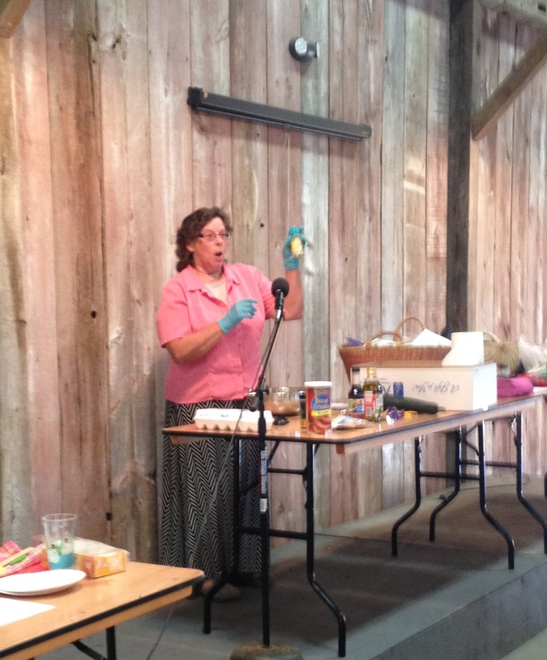
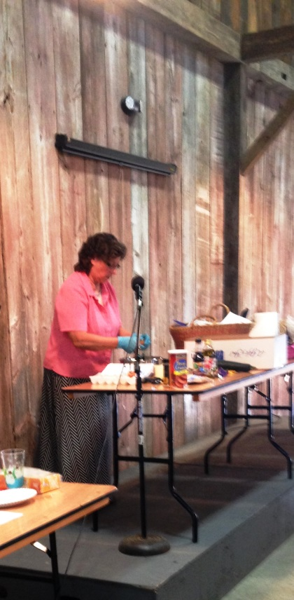
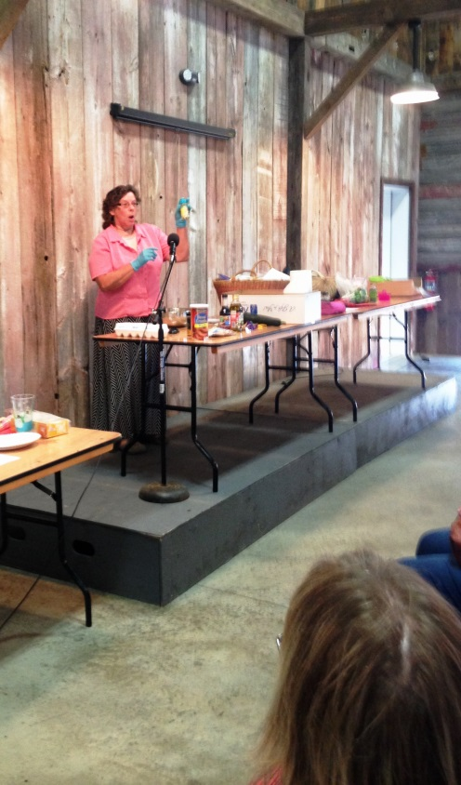
Chris Carl demonstrating her Pecan Patties – samples made with zucchini and recipes galore were made available!
How cool is that!

Slide 5

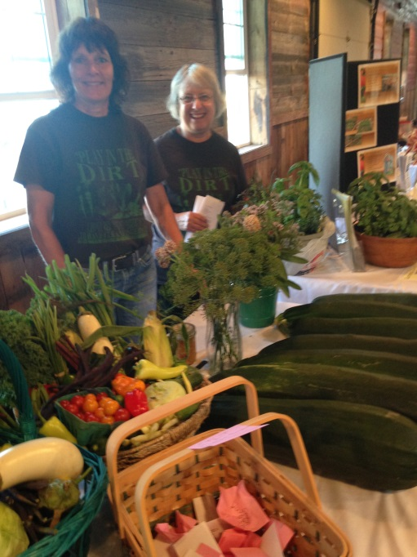
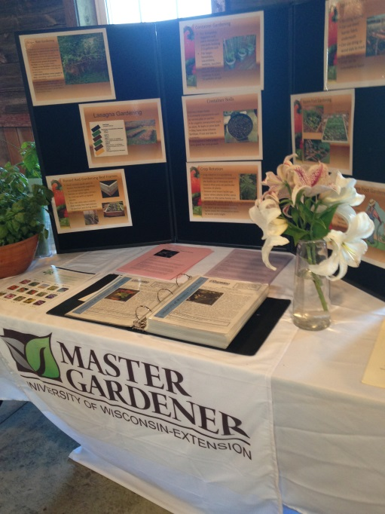
Check out our display!
Nancy and Judy ready to show the prizes and take on any questions from attendees.
Display offered many ways to talk dirt!

Slide 6
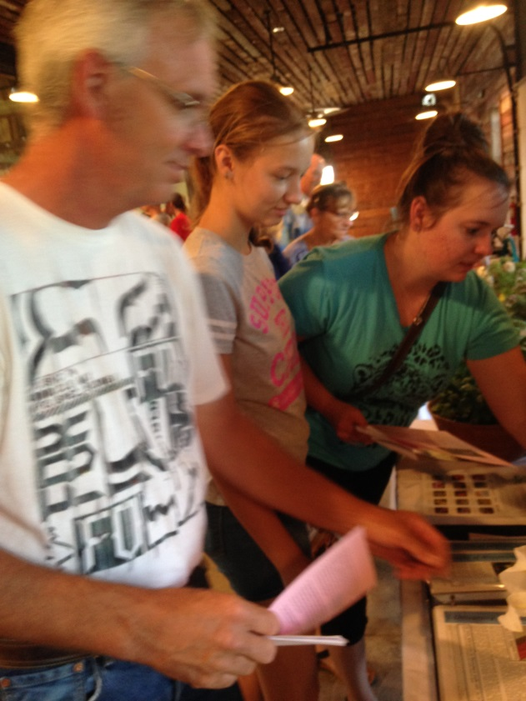
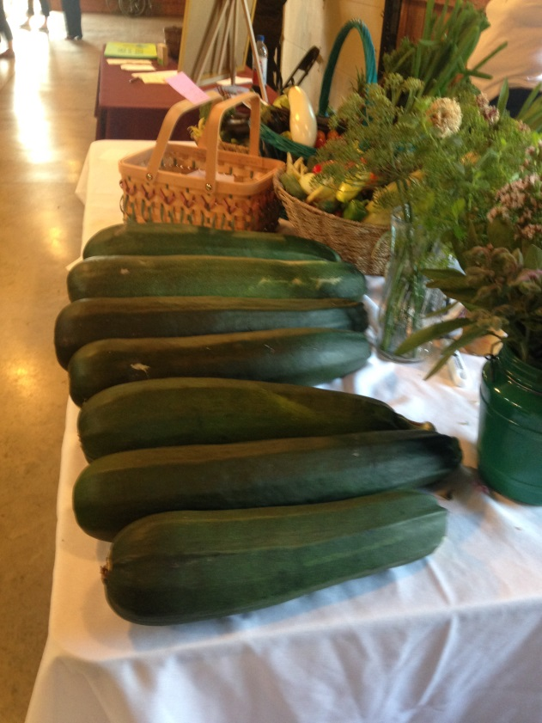
Time to Talk Dirt and Zucchini at our booth.

Slide 7
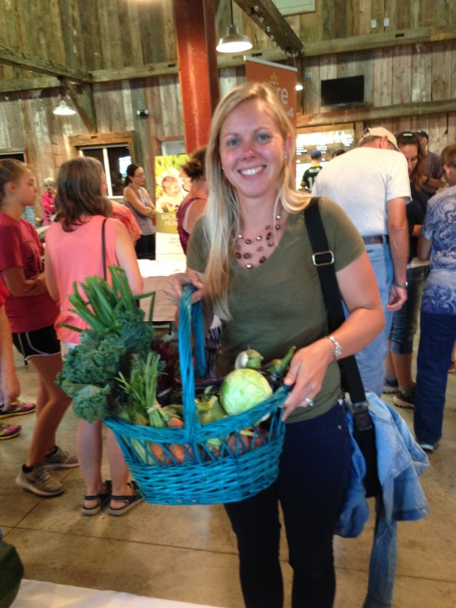
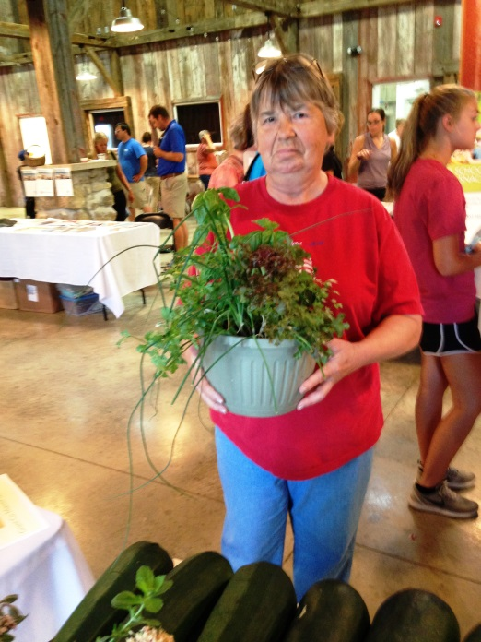
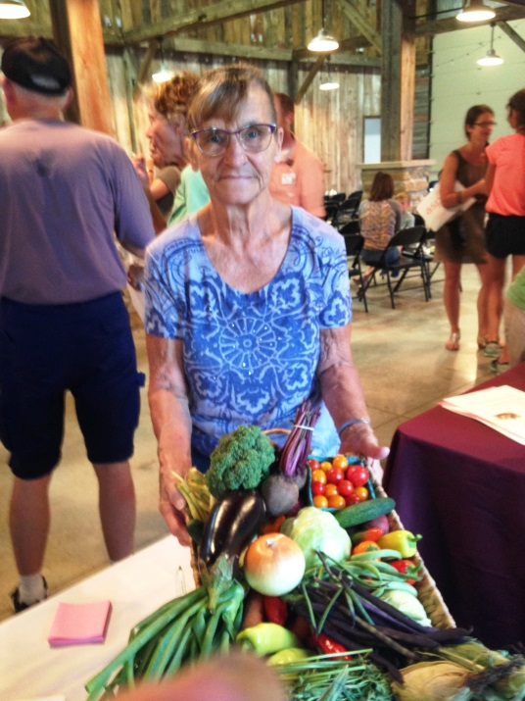
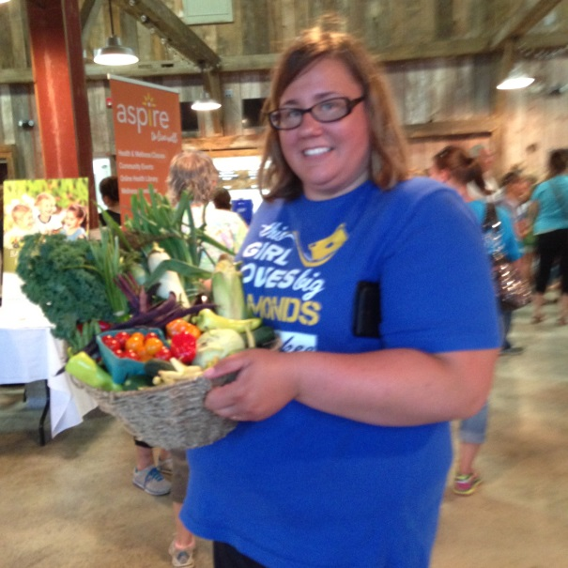
Look at the smiles from our winners of the produce basket and a herb planter. Good eats this week!!

Slide 8
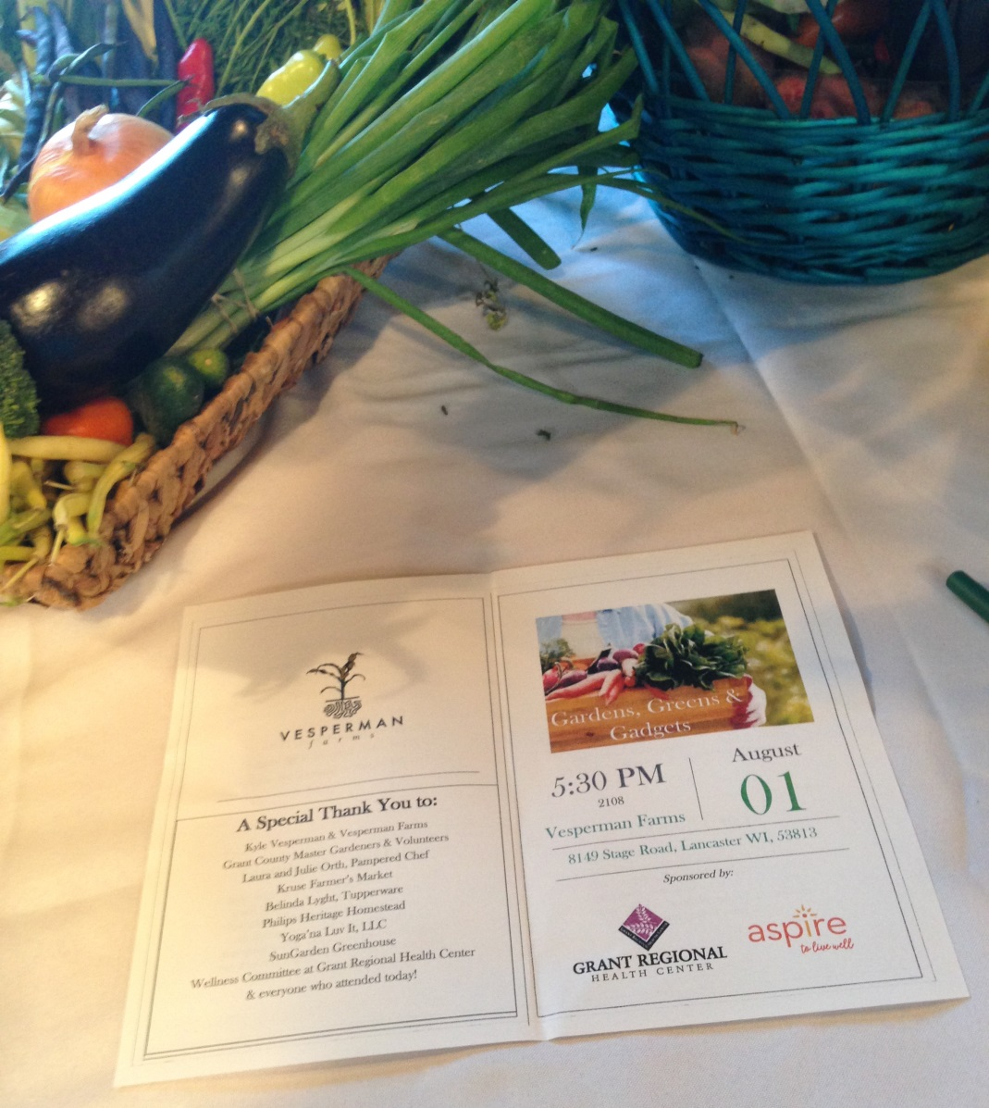
Thanks to all who made this event possible!

